Slide 1

Design Project 2 | Progress Presentation
Systems and Software Lab
An LMS with Smart Exam Proctoring
01

Slide 2





Design Project 2 |
Nafiul Quddus
ID 180042104
Team Members
Mirza Sadaf Shahid
ID 180042137
Muhammad Rafsan Quayes
ID 180042141
02

Slide 3
Design Project 2 |
Papers
Microservices: A Systematic Mapping Study
Claus Pahl and Pooyan Jamshidi
6th International Conference on Cloud Computing and Services Science, 2016
A Study on the Most Prominent Areas of Research in Microservices
Shamsul Sahibuddin, Mohammad Sadegh Hamzehloui, Ardavan Ashabi
International Journal of Machine Learning and Computing, 2019
Markos Viggiato, Ricardo Terra, Henrique Rocha, Marco Tulio Valente, Eduardo
Figueiredo
VI Workshop on Software Visualization, Evolution and
Maintenance, São Carlos - Brazil, 2018
Microservices in Practice: A Survey Study
03

Slide 4
Design Project 2 |
Papers
MILMS: A Microservices - based Learning Management System
Odysseas Tsilingeridis, Alexandros Karakasidis
IEEE International Conference on Big Data, 2020
Microservice architecture in E-learning
Ana Milovanović
The Fourteenth Advanced International Conference on Telecommunications, AICT 2018
04

Slide 5
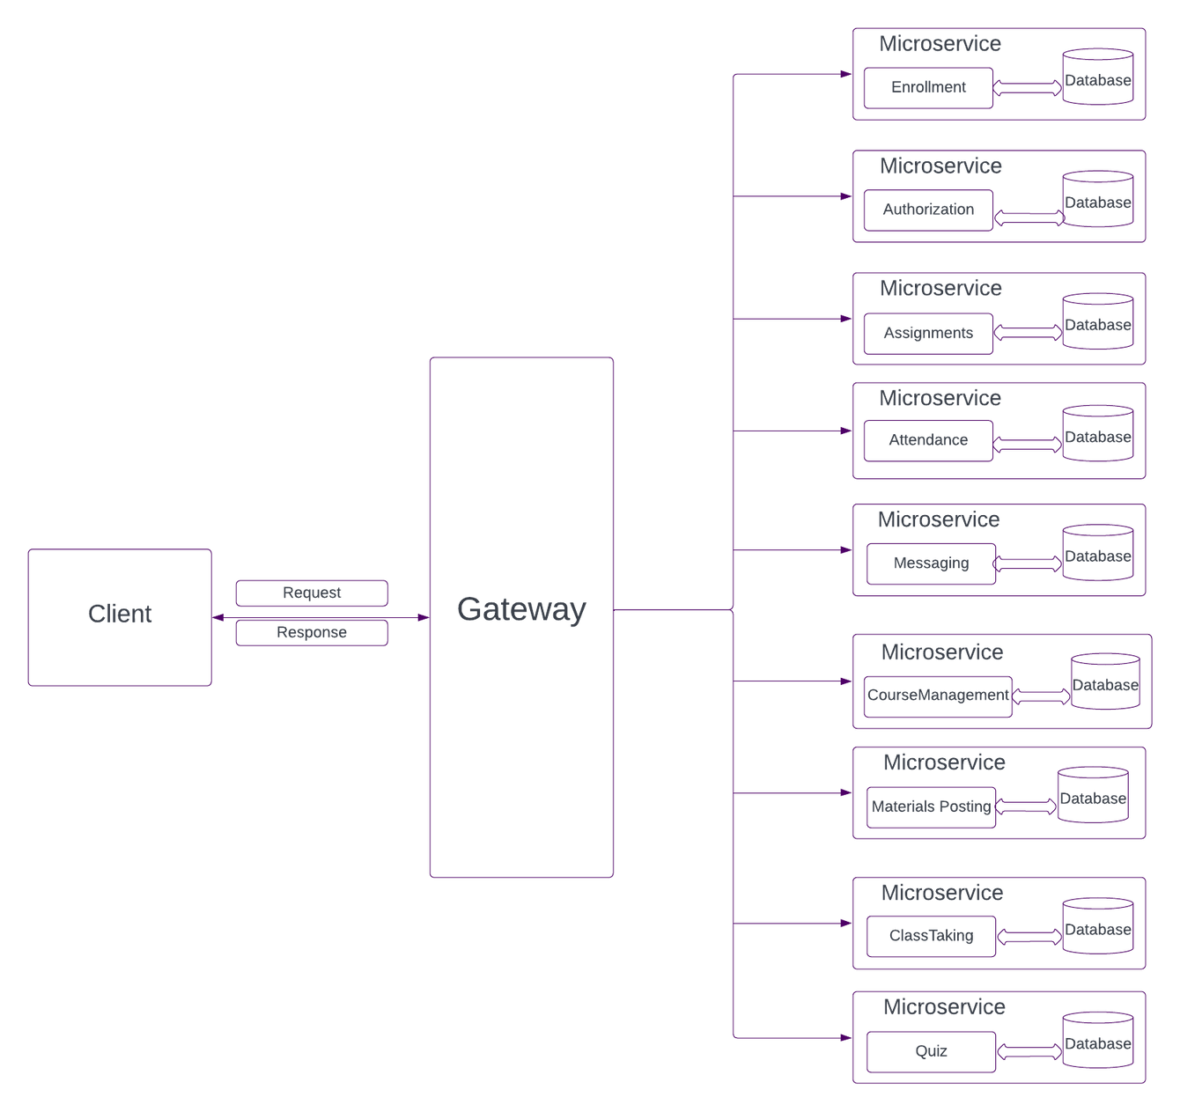
Design Project 2 |
Current Design
05

Slide 6
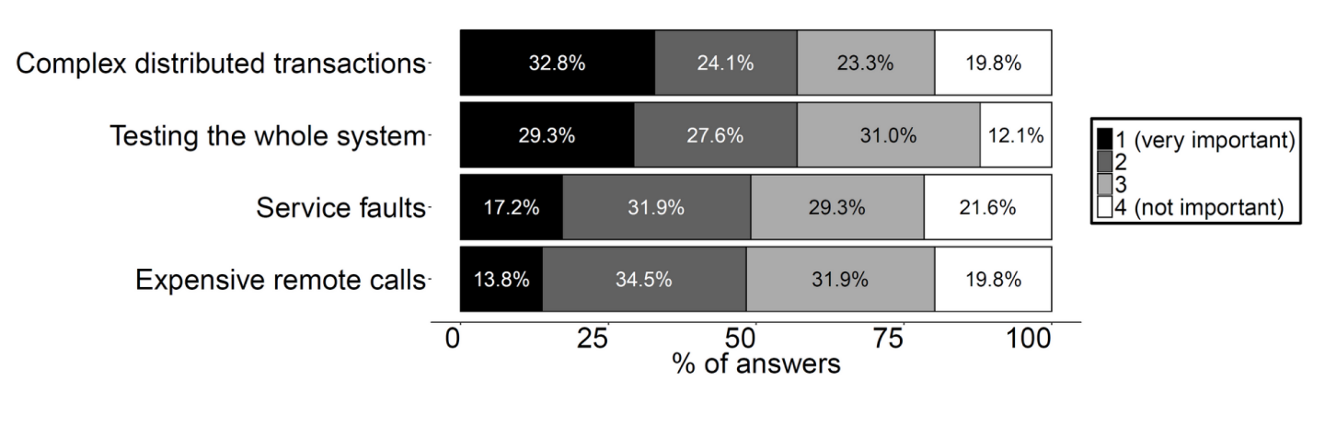
Design Project 2 |
Disadvantages / Challenges
*From "Microservices in Practice: A Survey Study", 2018
06

Slide 7

Design Project 2 |
Probable Solutions to the Challenges
Complex Distributed Transactions
Testing The Whole System
CQRS +/ Event Sourcing Pattern
Automate The Performance Testing
De-normalized Central Database
*An Architecture to Automate Performance Tests on Microservices, 2016
07

Slide 8
Design Project 2 |
What's Next
Command Query Responsibility Segregation Pattern and Event Souring Pattern
Test Automation - Both Functional and Non-Functional
Use Docker to set up a few services.
Yuxiang-Gao's Github Repository for Gaze Tracking Software
08

Slide 9
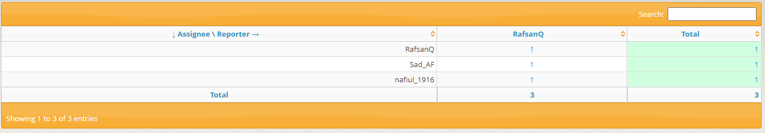
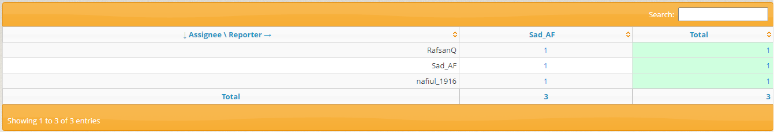
Design Project 2 |
Bugzilla Report
Resolved
In Progress
09

Slide 10
Design Project 2 |
Thank You for your patience.
The Floor is now open for Questions
10

